Slide 1
Piano Techniques and Effects in Piano Music: An Historical Approach to Pedaling
Dr. Karen W. Buckland
Northern Nevada Music Teachers Association Meeting
Steinway Piano Gallery (500 E. Moana Lane)
Wednesday, May 17, 10:00 a.m.

Slide 2
Pedals
historical research and performance practice
use of pedals for coloristic effects

Slide 3
Overview of the Fortepiano
Examples of Fortepianos and Builders
Characteristics of Early and Later Fortepiano
Designs
Inventions

Slide 4
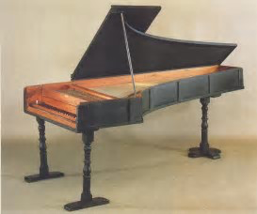
Historical Background of Keyboard Instruments Examples of Fortepianos and Builders
Cristofori 1720
Ptg.org

Slide 5
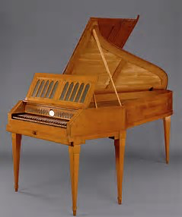
Viennese Fortepianos
Graf (Haydn)
Mozart (Stein)
Walter (Mozart)
metmuseum.org

Slide 6
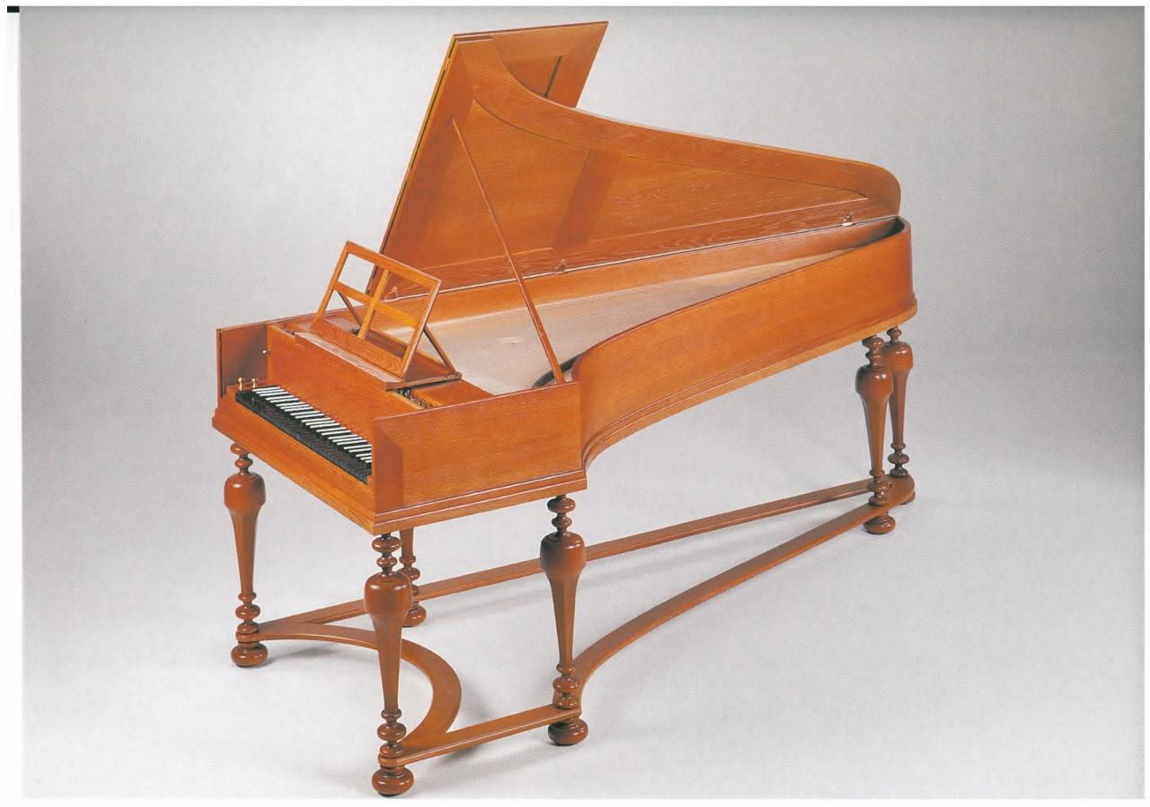
German Pianos
Silbermann (Bach)
Streicher (Beethoven)
Bechstein
Blüthner
Bösendorfer
Pohlmann
Steinweg miguelmorateorganologia.wordpre

Slide 7
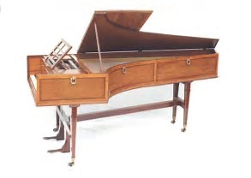
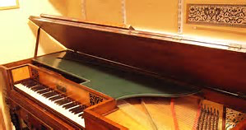
English Fortepianos
Broadwood (Beethoven)
(squarepianos.com)
Clementi (galleryhip.com)
(Érard)

Slide 8
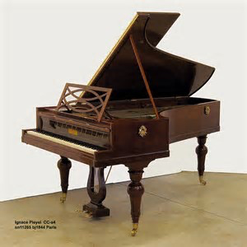
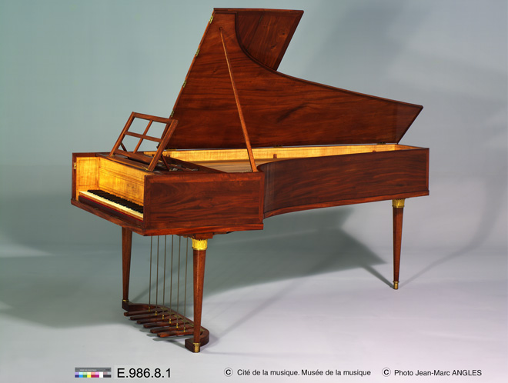
French Pianos
Érard (Liszt)
Pleyel (Chopin)
Gaveau, Pape

Slide 9
United States Pianos
Babcock (Boston, 1810)
Baldwin (Cincinnati, 1890)
Cable and Sons (NYC, 1852)
Charles Albrecht (Philadelphia and Long Island, 1759)
Chickering and Sons (Boston, 1823)
Knabe (Baltimore, 1837)
Mason and Hamlin (Boston, 1854)
Steinway (Steinweg) (NYC, 1850s)

Slide 10
Characteristics of Early Fortepiano
Wood frame (small grand)
Ability to play dynamics
Unwound bass strings
No pedals/Varied types of pedals
Small range

Slide 11
Characteristics of Later Fortepiano
Greater dynamic range
Larger size
Ornate
Addition of pedals
Metal frame
Cross stringing

Slide 12
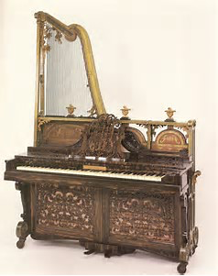
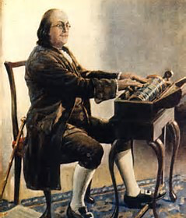
Designs
Grand (small and large)
Square
Upright
“Harp” Pianos
justbecause.com
Glass Harmonica
thomasbloch.net

Slide 13
Inventions
1810 Érard double escapement - Liszt
1820 Pape over stringing (first patent in US by Steinway in 1859)
1825 Cast iron frame
1873 Aliquot stringing

Slide 14
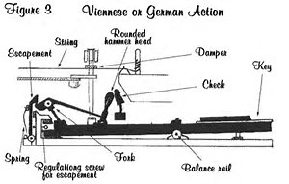
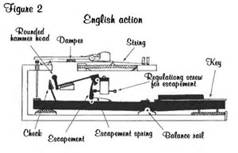
Escapement
Lvbeethoven.fr

Slide 15
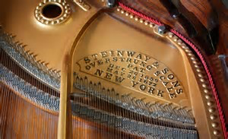
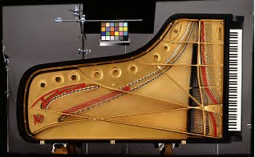
Over Stringing and Cast Iron Frame
Reverb.com
yost.com

Slide 16
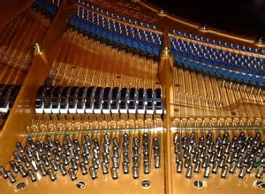
Aliquot Stringing Invented by Blüthner
Additional un-struck string in the top three octaves
Not in contact with hammers
Sympathetic vibration
Adds color and resonance
to the entire instrument
Courtneypianos.co.uk

Slide 17
Pedals: Types and Function
Modern Piano
1. Damper Pedal
una corda Pedal
Sostenuto Pedal (1875 Steinway)
Practice Pedal
Dampen by Hand

Slide 18
Pedals: Fortepianos/Early Pianofortes
Knee Levers
Stein, Walter, Silbermann, Broadwood, Clementi
Locations: centrally located or on sides (Haydn)
Right Knee raises only treble; Left Knee raises all dampers
Initially used to dampen chords

Slide 19
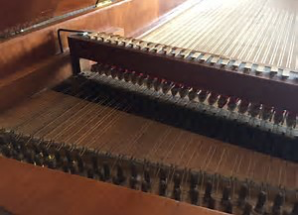
Moderator
Allows string to “sing”
Layer of leather (deerskin) or
soft cloth between hammer
and strings
Play with knees
earlypiano.co.uk
Requires a longer pedal to sustain tones

Slide 20
Foot Pedals
Initially on side, later in the middle
Attributed to London builders (Broadwood)
Mozart – “provided resonance and vibration”
a. Split Damper
b. Lute Stop, Moderator, Bassoon Stop, Celeste
c. Pianissimo Stop
d. Janissary Pedal (Mozart “Rondo alla Turca” and Beethoven)
e. una corda
f. Sostenuto

Slide 21
Pedal Piano
Piano with built-in pedal board or a separate pedal board with set of strings attached to a grand piano
Derived from cimbalom with additional keyboard set on top of strings
Initially no dampers, later added dampers
Mozart (owned a Hammerflügel with pedal board by Anton Walter), Schumann, and Mendelssohn

Slide 22
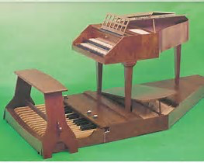
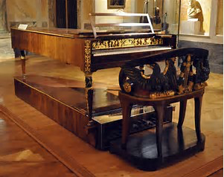
Pedal Piano (Hammerflügel with Pedal Board)
jc-neupert.de
commons.wikimedia.org

Slide 23
Swell Pedal (Johannes Pohlmann)
Could raise and lower the lid of the piano
Controlled volume
Hand Stop
Pedal Manipulated by hand
May require two people

Slide 24
Pedal Techniques
Symbols: u.c., due and tre, damper, dotted line, solid line, ped
Types of pedaling: Sustain, Touch, Flutter, Quarter, Half,
Three-Quarter, Full, Overlapping, Delayed, Accented, Rhythmic, Syncopated

Slide 25
Samuel Maykapar Pedal Prelude 2

Slide 26
Maykapar Prelude 4

Slide 30
Mozart Sonata in F Major, K. 332, mvt. I

Slide 32
Beethoven “Pathetique”, mvt. 2

Slide 33
Critical and Creative Listening to the Pedal
Introduction to and the Mechanics of the Pedals
Explanation of Pedal Use
Importance of Seating and Balance
Duets, Duos, Trios, and Quartets
Decisions Based on Listening (Pre- and During Performance)

Slide 34
Create Exercises for Listening to the Pedal
Five-Finger Patterns, Scales, Arpeggios,
Chords, and Harmonic Progressions
Use Various Types of Pedaling with Bass and Pedal; Treble and Pedal; Combined Treble, Bass and Pedal; Harmonic Progressions and Pedal
Make Decisions Based on Listening

Slide 35
Decisions Based on Style and Performance Practice (facsimile vs. modern editions)
When and How to Use?
Create Initial Resonance
Scalar Passages and Harmonic Use
Sustain
Sound and Color
Dynamic Contrasts

Slide 36
Use of the Pedal
Specific Directions by the Composer
Not as a Substitute for Finger Legato or Poor Technique
Chromatic Passages (Especially in the Bass)
Arpeggios (Combinations)
Clarity of Articulation

Slide 37
Samples of Pedaling in Repertoire Bach Prelude in C Major, BWV 846

Slide 38
Haydn Sonata in C Major, Hob. XVI/50, mvt. 1

Slide 39
Beethoven “Pathetique” Sonata Rondo

Slide 41
Beethoven Sonata in d minor (“Tempest”), Op. 31, No. 2

Slide 44
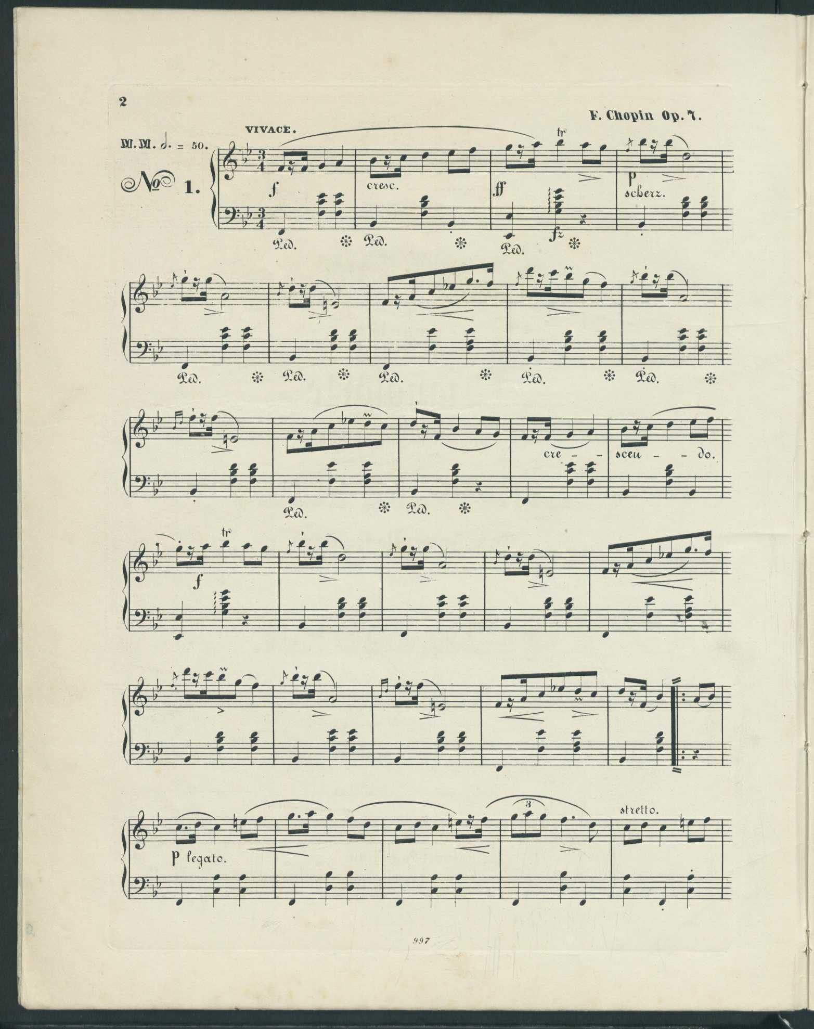
Chopin - interpreting his pedal markings Mazurka on B-flat Major, Op. 7, No. 1

Slide 46
Chopin Étude in E Major, Op. 10, No. 3

Slide 47
Prélude in D-flat Major, Op. 7, No. 1 (“Raindrop”)

Slide 49
Grande valse brillante in E-flat Major, Op. 18

Slide 51
Mendelssohn Duetto, Op. 38, No. 6

Slide 53
Debussy

Slide 55
Debussy

Slide 57
Schoenberg Sechs kleine Klavierstücke, Op. 19, No. 6

Slide 58
Summary

Slide 59
Sources
Bach, Carl Philipp Emmanuel. Essay on the True Art of Playing Keyboard Instruments. Translated and Edited by William J. Mitchell. New York: W.W. Norton and Co., 1974.
Badura-Skoda, Eva and Paul. Interpreting Mozart: The Performance of His Piano Pieces and Other Compositions. Second Edition. New York: Routledge, Taylor and Francis Group, LLC, 2008.
Badura-Skoda, Eva. The History of the Pianoforte: A Documentary in Sound. Bloomington: Indiana University Press, 1999. Video
Crombie, David. Piano: Evolution, Design and Performance. New York: Barnes and Noble, 1995.
Czerny, Carl. Complete Theoretical and Practical Piano Forte School, Op. 500. Vienna: A. Diabelli and Comp., 1838. Petrucci Music Library. IMSLP.org
de Silva, Preethi, translated. The Fortepiano Writings of Streicher, Dieudonné, and the Schiedmayers (Two Manuals and a Notebook, Translated form the Original German, with Commentary). Foreword by Malcolm Bilson. Lewiston, NY: The Edwin Mellen Press, 2008.
Drake, Kenneth. Classic and Romantic Pianos. web-site http://classicandromanticpianos.org/performance.html
Drake, Kenneth. Journal for Young Pianists. web-site http://classicandromanticpianos.org/performance.html
Drake, Kenneth. The Beethoven Sonatas and the Creative Experience. Bloomington: Indiana University Press, 1994, 2000 (Index).

Slide 60
Fink, Seymour. Mechanics of the Piano. From A Symposium for Pianists and Teachers: Strategies to Develop the Mind and Body for Optimal Performance. Edited by Kris Kropff. Foreword by Luiz de Moura Castro. Dayton: Heritage Music Press, a division of The Lorenz Corporation, 2002.
Fraser, Alan. The Craft of Piano Playing: A New Approach to Piano Technique. Lanham, MD: The Scarecrow Press, Inc., 2003.
Gunn, Donna Louise. Discoveries form the Fortepiano: A Manual for Beginning and Seasoned Performers. Oxford: Oxford University Press, 2016.
Komlós, Katalin. Fortepianos and Their Music: Germany, Austria, and England 1760-1800. Oxford: Clarendon Press, 1995.
Libin, Laurence. Keyboard Instruments. New York: The Metropolitan Museum of Art, Summer 1989.
Palmieri, Robert, general editor. Encyclopedia of Keyboard Instruments. New York: Garland, 1994.
Rosenblum, Sandra P. Performance Practices in Classic Piano Music: Their Principles and Applications. Foreword by Malcolm Bilson. Bloomington: Indiana University Press, 1991.
Rowland, David. Early Keyboard Instruments A Practical Guide. Cambridge: Cambridge University Press, 2001.
Shrader, David. Piano evolution, history of keyboard instruments. YouTube: https://www.youtube.com/watch?v=jMwM9AEkzsQ

Slide 61
List of Repertoire (Excerpts)
List of Repertoire (Excerpts): Scores from Petrucci Music Library (IMSLP.org)
Prelude in C Major, BWV 846 by Johann Sebastian Bach
Sonata in C Major, Hob. XVI/50, mvt. I by Franz Joseph Haydn
Sonata in F Major, K. 332 , mvt. I by Wolfgang Amadeus Mozart
Sonata No. 11, K. 331, mvt. III (“Rondo alla Turca”) by Wolfgang Amadeus Mozart
Sonata in d minor, (“Tempest”), Op. 31, No. 2 by Ludwig van Beethoven
Sonata in c minor (“Pathetique), Op. 13, mvt. II, by Ludwig van Beethoven
Sonata in c minor (“Pathetique”), Op. 13, mvt. III, by Ludwig van Beethoven
Mazurka in B-flat Major, Op. 7, No. 1 by Frédéric Chopin
Prélude in D-flat Major (“Raindrop”), Op. 28, No. 15 by Frédéric Chopin
Grande valse brillante in E-flat Major, Op. 18 by Frédéric Chopin
Étude in E Major, Op. 10, No. 3 by Frédéric Chopin
Duetto, Op. 38, No. 6 by Felix Mendelssohn
Clair de Lune from Suite Bergamasque by Claude Debussy
Prelude from Pour Le Piano by Claude Debussy
Sechs kleine Klavierstücke, Op. 19, mvt. VI, by Arnold Schoenberg
Maykapar, Samuel. Pedal Preludes for Piano. Translated from the Russian by Sergei Mihailoff in collaboration with Nicholas Petlin. Evanston: Summy-Birchard Company, 1974.

